Slide 1


DataSHIELD beginners workshop
September 2025
Tim Cadman
Senior Data Scientist

Slide 2
Accessing the workshop
Navigate to https://lifecycle.analysis.molgenis.org/
Click `Sign in with MOLGENIS`
Enter your username and password (will be provided)
  User format: userx@datashield.org
  Password: dsworkshop24
Click on ‘DataSHIELD – Donkey-Lemon’ (might take a little time)
Click on `Rstudio` icon
Open the file `DataSHIELD Beginners Workshop 25`

Slide 3

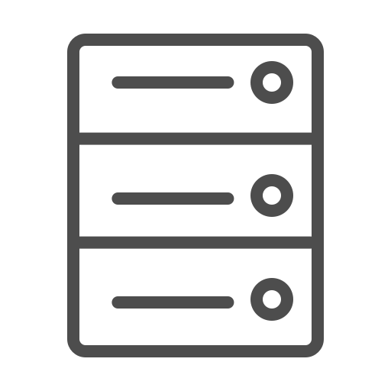
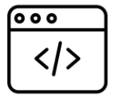



Analysis with DataSHIELD
Setup
Cohort A
Armadillo /
Opal server
Central
analysis server
Cohort B
Armadillo /
Opal server
Researcher
Cohort C
Armadillo /
Opal server
Request access

Slide 4
Analysis with DataSHIELD
Setup
In R you have one workspace
In DataSHIELD you have two!
Cohort A
Armadillo /
Opal server
Central
analysis server
Cohort B
Armadillo /
Opal server
Researcher
Cohort C
Armadillo /
Opal server
Request access

Slide 5
Analysis with DataSHIELD
Setup
Server-side workspace (participant data, cannot view raw data)
Cohort A
Armadillo /
Opal server
Central
analysis server
Cohort B
Armadillo /
Opal server
Researcher
Cohort C
Armadillo /
Opal server
Request access

Slide 6
Analysis with DataSHIELD
Setup
Server-side workspace (participant data, cannot view raw data)
Client-side workspace (summary statistics)
Cohort A
Armadillo /
Opal server
Central
analysis server
Cohort B
Armadillo /
Opal server
Researcher
Cohort C
Armadillo /
Opal server
Request access

Slide 7
Workshop
Let’s get started …

Slide 8
Additional support
For additional support on DataSHIELD analysis, we have:
DataSHIELD wiki https://wiki.datashield.org/en/analysis-tutorials
DataSHIELD Slack channel (contact support@molgenis.org to be added)
DataSHIELD drop-in session Wednesday 10am CET
(zoom link)
DataSHIELD forum (https://datashield.discourse.group/)

