Slide 1


Introduction to DataSHIELD
Bringing the analysis to the data
Tim Cadman
Senior Data Scientist

Slide 2


About me
Psychologist & Epidemiologist
8 years DataSHIELD researcher
Currently at Molgenis developing DataSHIELD and Armadillo

Slide 3

Overview
Introduction (1 hour)
Why combine data?
Federated analysis
Introducing DataSHIELD
Demo
Lunch (1 hour)
Parallel workshops (3 hours)

Slide 4
Background
Combining data sources

Slide 5
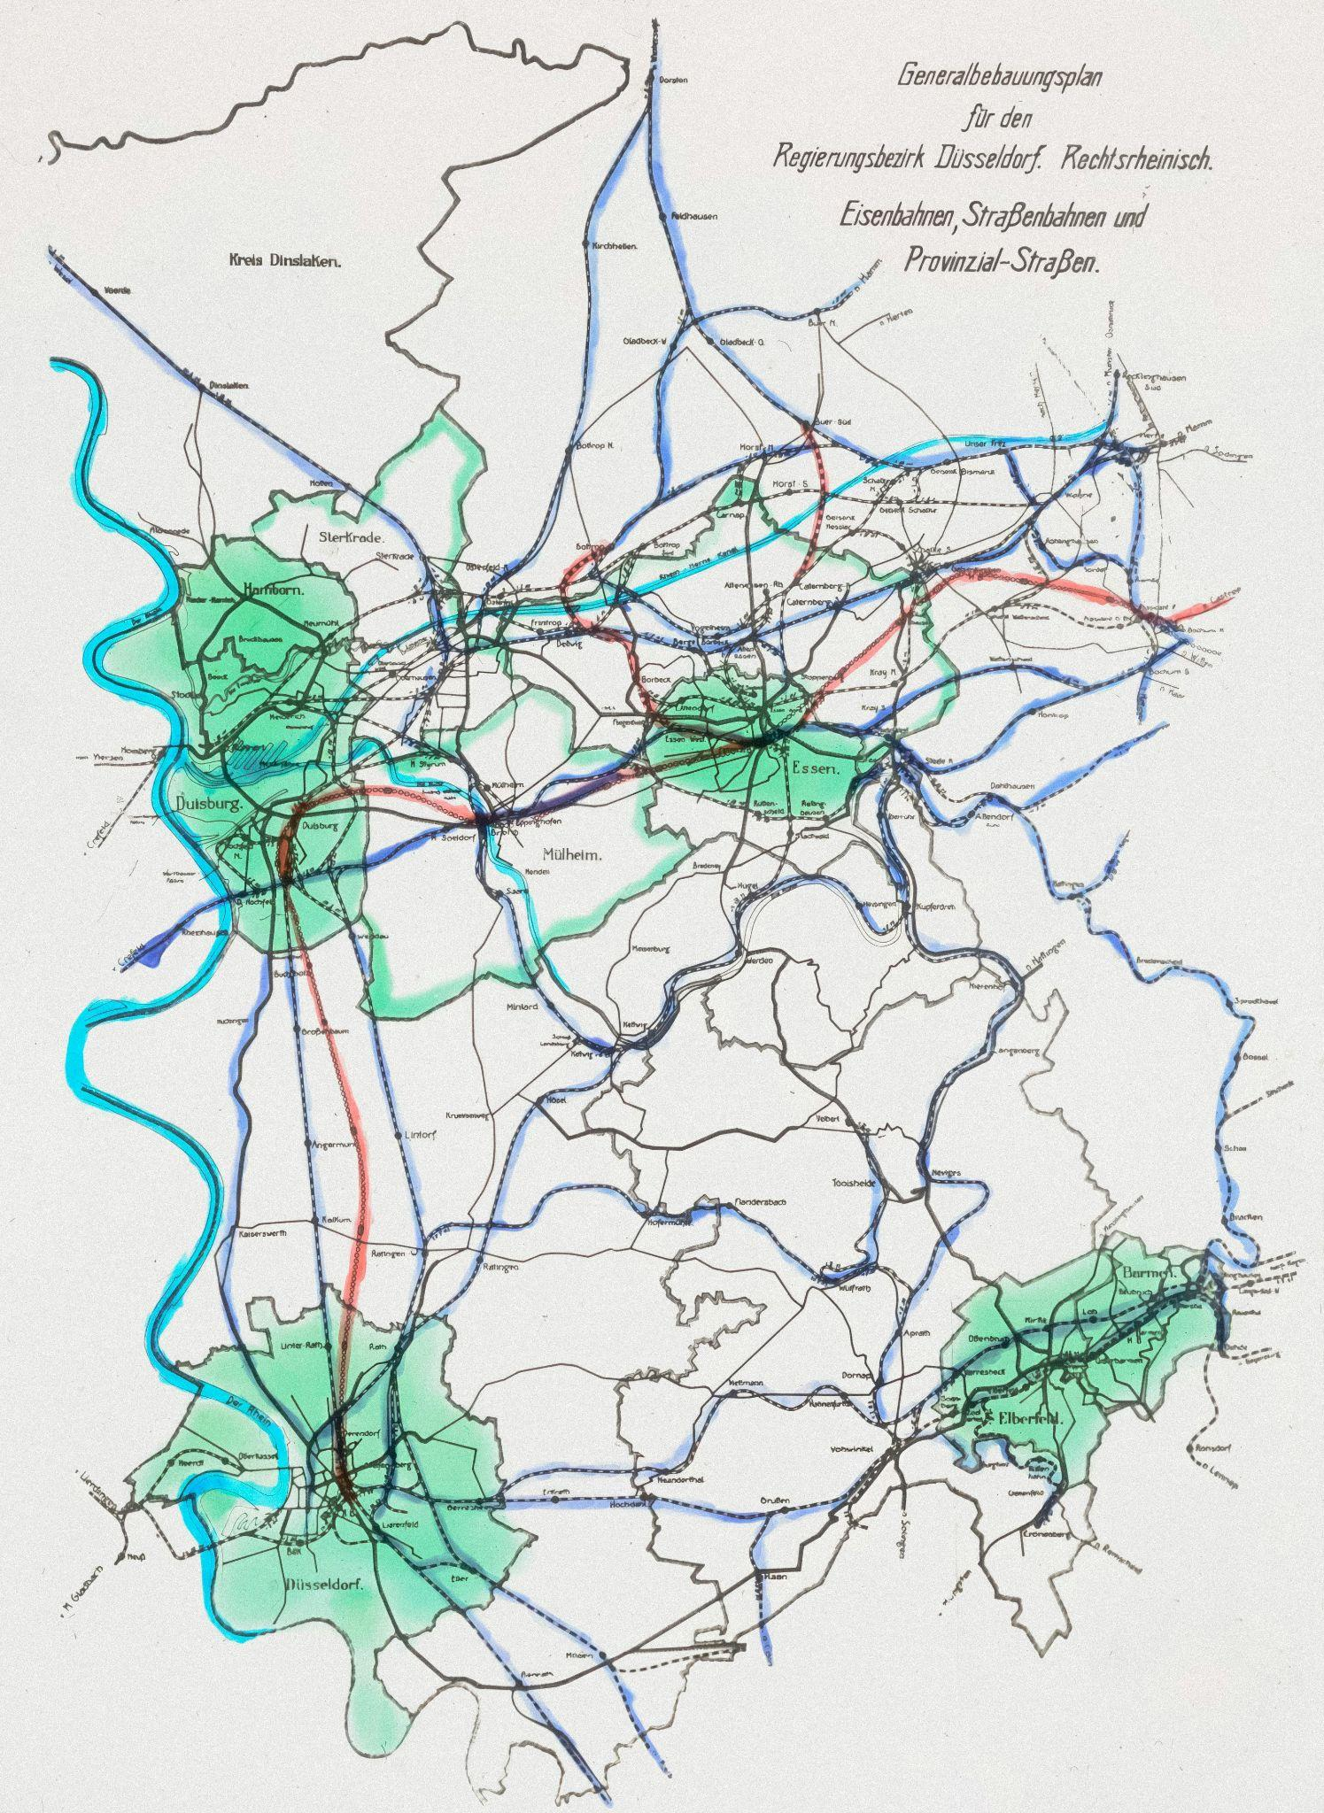
Background
Why combine data?
Large quantities of existing data (e.g. cohort studies, biobanks)
Combining data sources allows:
Statistical power
Replication across settings
Extended coverage of the lifecourse

Slide 6

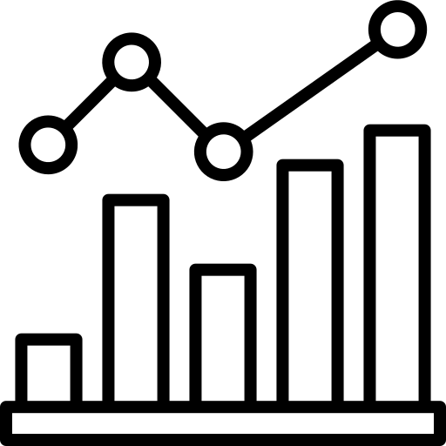

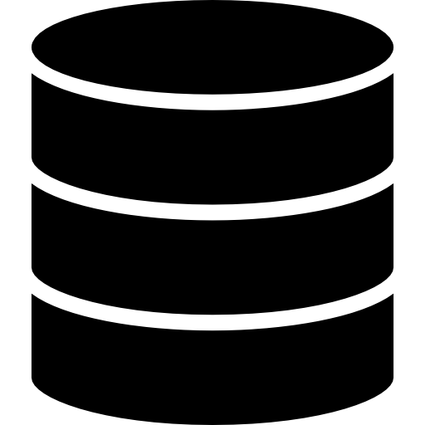
Background
Approaches to combining data
Move data to one location
Conduct analysis separately and combine results
Federated analysis

Slide 7

Background
Approaches to combining data
Move data to one location
Conduct analysis separately and combine results
Federated analysis

Slide 8


Background
Approaches to combining data
Move data to one location
Conduct analysis separately and combine results
Federated analysis

Slide 9
Combining data
Option 1: Data transfer
Strategy: Transfer to one location
Pros: One researcher conducts all analyses
Cons:
Ethico-legal restrictions
Data owners lose control of data
Storage demands (e.g. omics)

Slide 10
Combining data
Option 2: Separate analysis
Strategy: Separate analysis & meta-analysis
Pros: No sharing of data
Cons:
Inefficient
Limited to two-stage methods

Slide 11
Combining data
Option 3: Federated analysis
Strategy: Remote analysis
Pros:
Data owners retain control
No sharing of private data
One researcher runs analyis
Cons: Technical requirements

Slide 12
Background
Federated analysis

Slide 13
Federated analysis
Batch vs interactive
Two main approaches to federated analysis:
Batch submission
Interactive analysis

Slide 14
Federated approaches
Batch submission
Submit pipeline → results
Work interactively with data
Batch
Execution

Slide 15
Federated approaches
Interactive approach
Submit pipeline → results
Work interactively with data
Batch
Execution

Slide 16
Federated approaches
Batch execution
Example platforms: Flower, Vantage6
Ideal use case: Machine learning; QCd data
Disadvantages: Difficult to explore data

Slide 17
Federated approaches
Interactive working
Example platform: DataSHIELD
Ideal use case: Epidemiological or life sciences research
Disadvantages: More limited analysis options

Slide 18
Datashield
An introduction

Slide 19



Datashield
What is it?
R-based federated platform
Facilitates connection to multiple data sources
Data controllers host data and control access rights

Slide 20
Datashield
What is it?
The researcher queries the data using R
Summary statistics and model results are returned
The researcher is blocked from viewing individual-level data

Slide 21
Datashield
Privacy controls
Example disclosure controls:
Not returning cells with small N
Not running models with too many parameters
Anonymising graphs
https://wiki.datashield.org/en/opmanag/disclosure-control

Slide 22
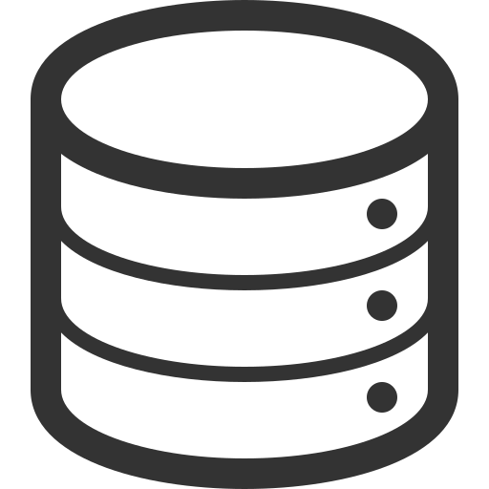




Datashield
Simple setup
Cohort A
Armadillo / Opal server
Cohort B
Armadillo / Opal server
Researcher
Cohort C
Armadillo / Opal server
Request access

Slide 23

Datashield
Setup

Slide 24
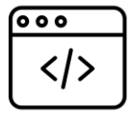
Datashield
Central analysis server setup
Cohort A
Armadillo / Opal server
Central analysis server
Cohort B
Armadillo / Opal server
Researcher
Cohort C
Armadillo / Opal server
Request access

Slide 25
Datashield
Analysis possibilities
Core functions & data preparation
dsBase: Satistical, reshaping, and utility functions.
dsTidyverse: Data manipulation
dsResource: Connections to different resource types
Generating synthetic data
dsSynthetic: Generate non-disclosive synthetic datasets

Slide 26
Datashield
Analysis possibilities
Causal & Regression Analysis
dsBase: Regression models; multiple imputation
dsSurvival: Cox models and survival curves
dsMediation: Causal mediation
Machine learning
dsML: ML functions (PCA, K-means, SVD, etc.)
dsMTL: Federated multi-task learning, LASSO
dsClusterAnalysis: Clustering

Slide 27
Datashield
Analysis possibilities
Omics, Microbiome, Exposome
dsOmics: Differential expression, PLINK, VCF
dsMicrobiome: Microbiome analysis via vegan.
dsExposome
For a full list see: https://wiki.datashield.org/en/opmanag/community_packages

Slide 28
Datashield
A demonstration

Slide 29
Datashield
What does it look like?
It depends what your role is …

Slide 30

Datashield
What does it look like?
Systems administrator: Terminal
Data manager: UI for managing data and users
Researcher:
RStudio

Slide 31
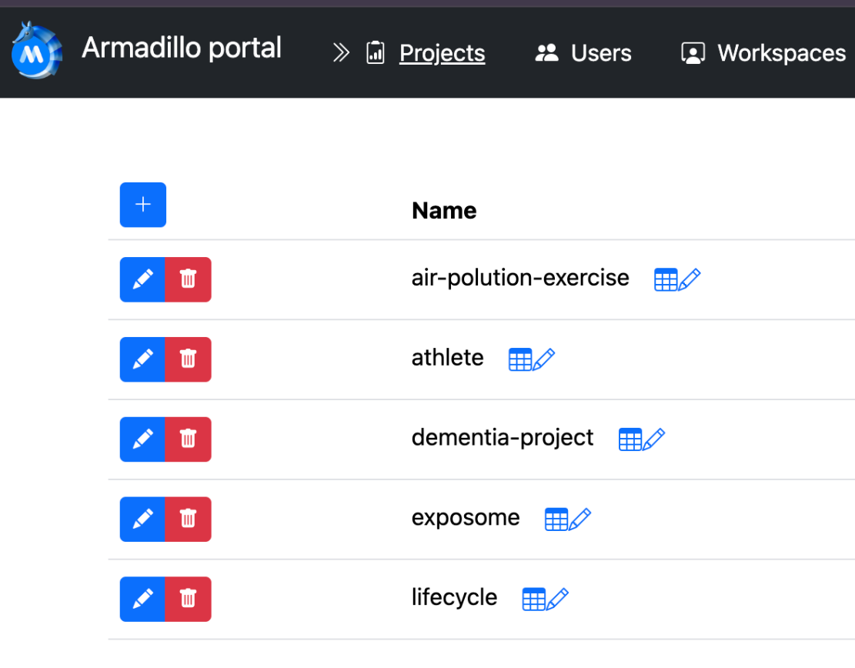
Datashield
What does it look like?
Systems administrator: Terminal
Data manager: UI for managing data and users
Researcher:
RStudio

Slide 32
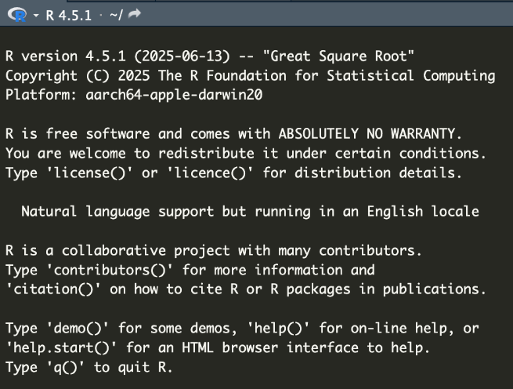
Datashield
What does it look like?
Systems administrator: Terminal
Data manager: UI for managing data and users
Researcher:
RStudio

Slide 33
Demo
Data manager

Slide 34
Demo
Researcher

Slide 35
Datashield
Further information

Slide 36
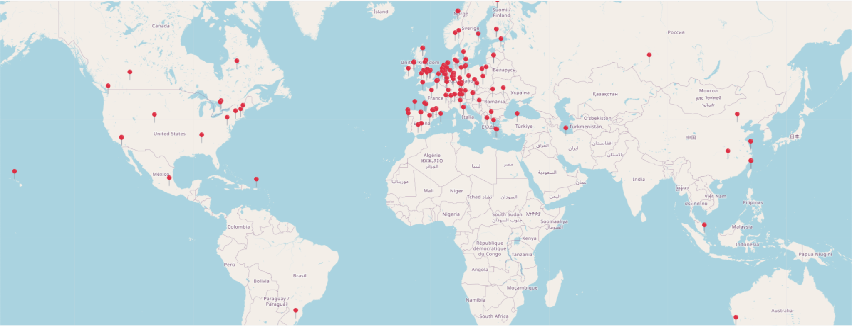
User base

Slide 37
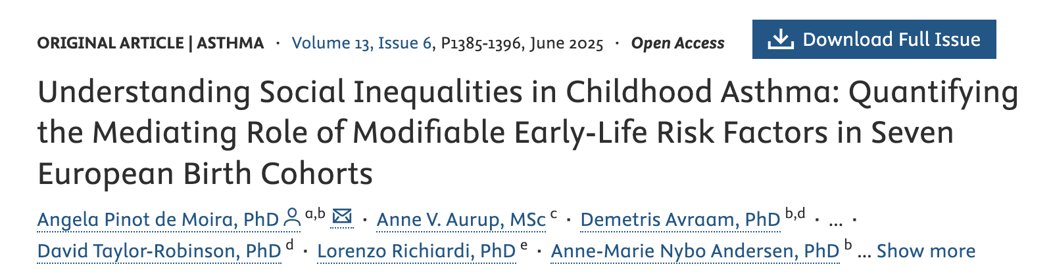
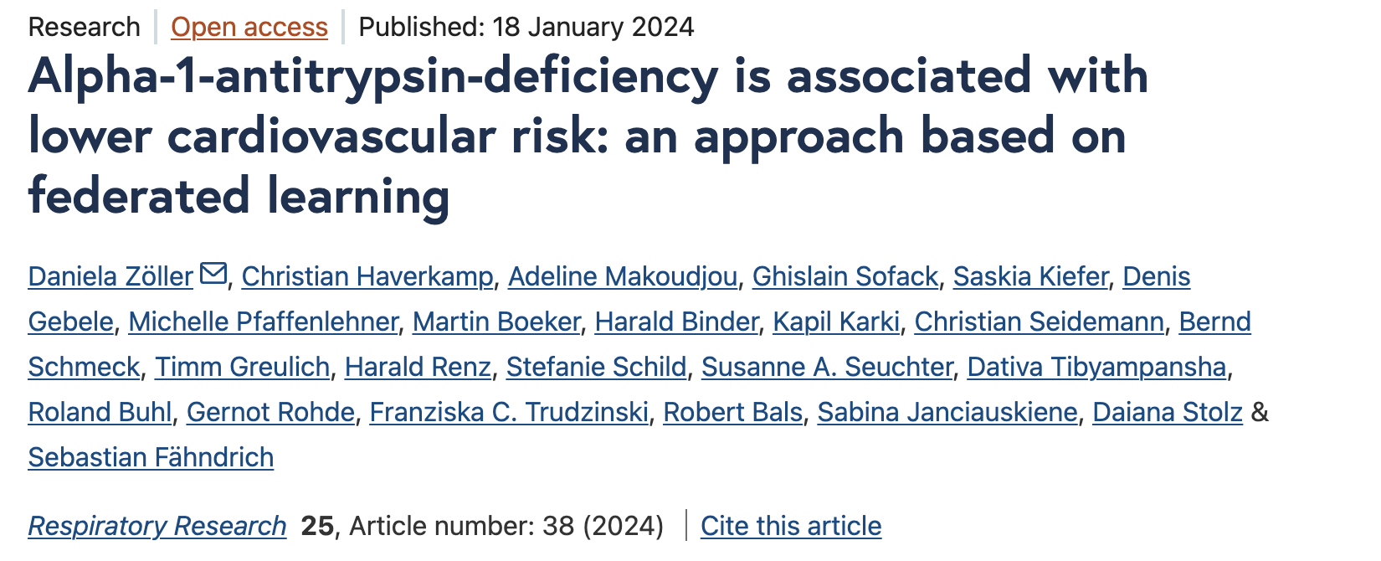
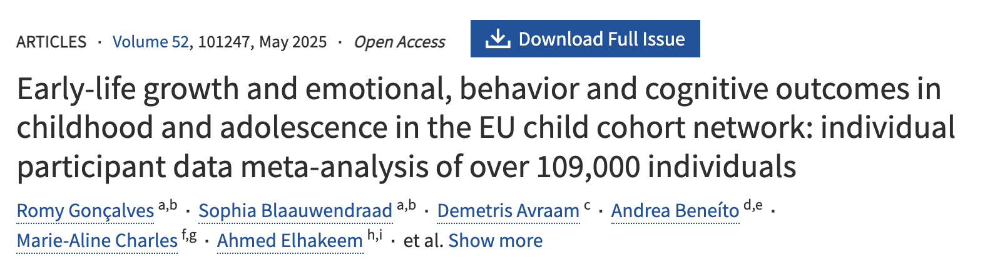
Example Publications

Slide 38
Thank you!
ATHLETE project (https://athleteproject.eu/)
International Human Exposome Network (https://humanexposome.net/)
Molgenis colleagues and DataSHIELD community
Questions?
support@molgenis.org

Slide 39
Useful links
DataSHIELD wiki:​ https://wiki.datashield.org/
DataSHIELD website: https://datashield.org/
DataSHIELD forum: https://datashield.discourse.group/
Molgenis suite: https://molgenis.org/
Molgenis catalogue: https://data-catalogue.molgeniscloud.org/
Armadillo paper: https://doi.org/10.1093/bioinformatics/btae726
Armadillo docs: https://molgenis.github.io/molgenis-service-armadillo/
Opal docs: https://opaldoc.obiba.org/

